Slide 1
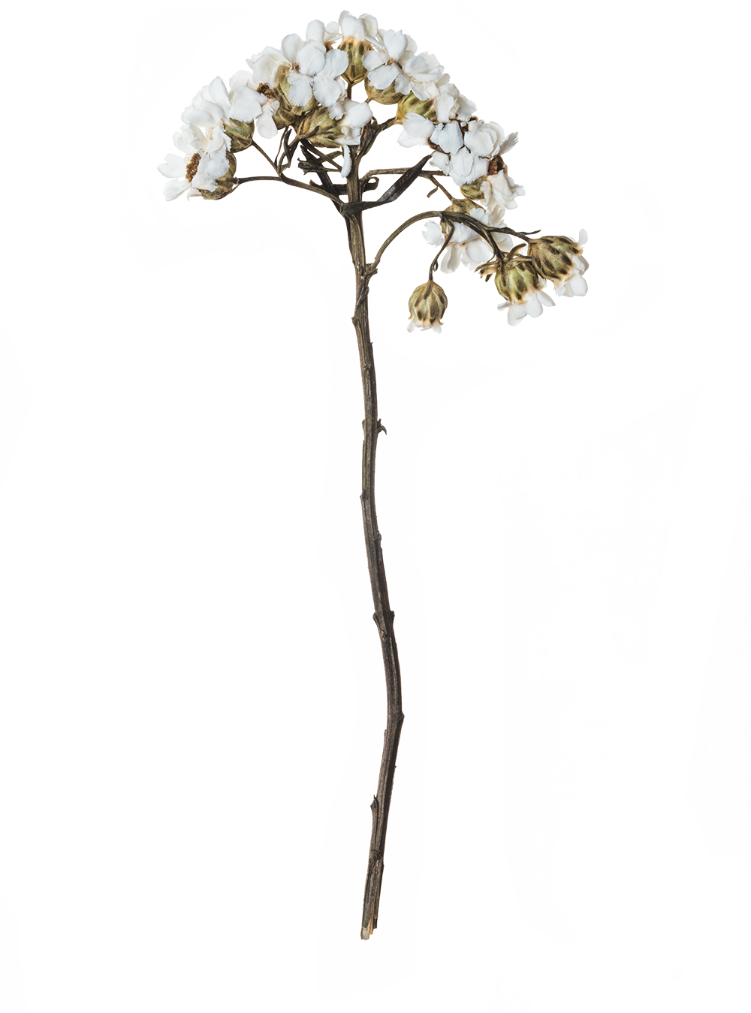

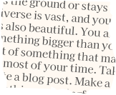

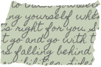
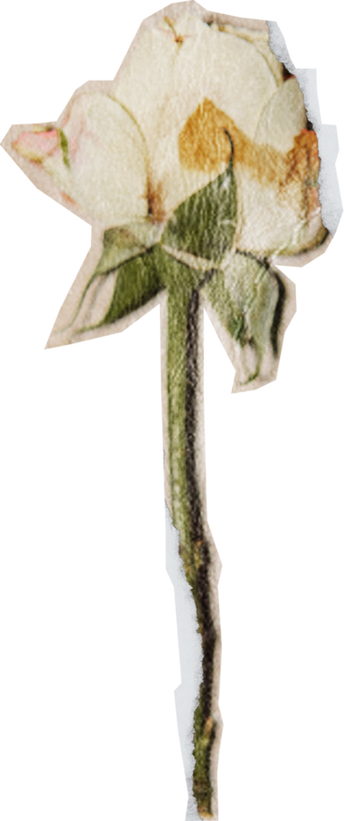



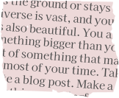
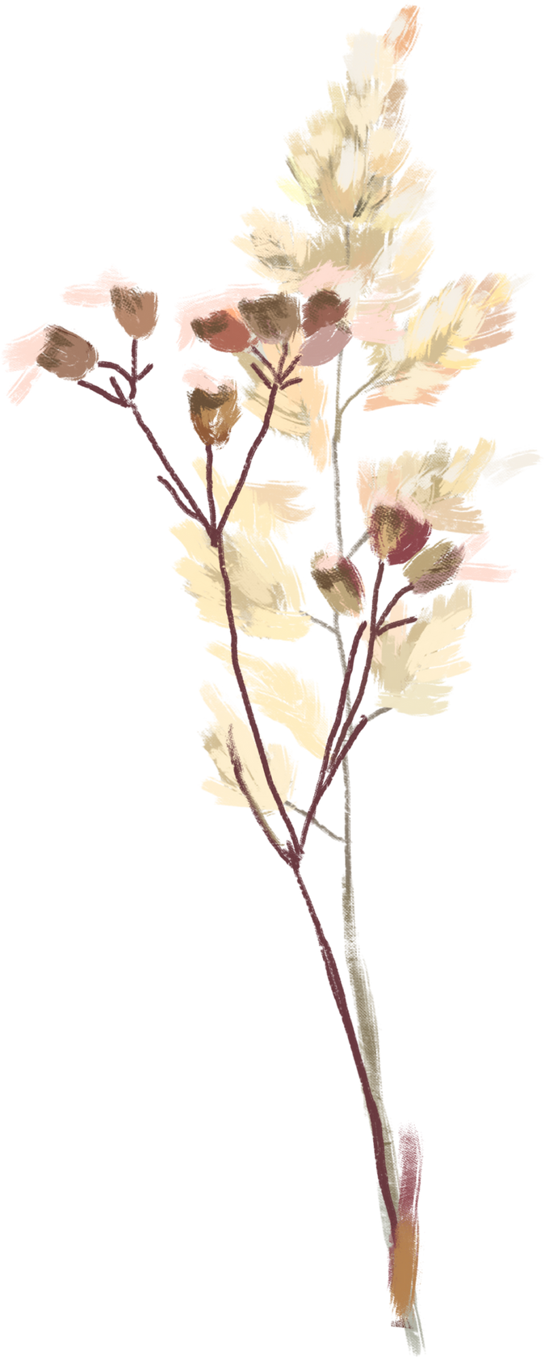

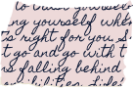
digital
PORTFOLIO

Slide 2

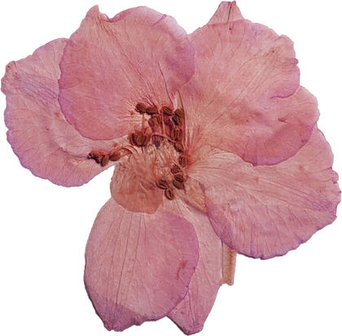
STUDENT NAME: S. PAVITHRA
REGISTER NO AND NMID: 222404649/ B16079EACD15083A74642C32C977827C
DEPARTMENT: B.sc Computer Science with AI
COLLEGE: AGURCHAND MANMULL JAIN COLLEGE, CHENNAI
UNIVERSITY: University of Madras

Slide 3
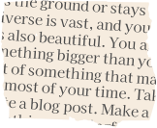
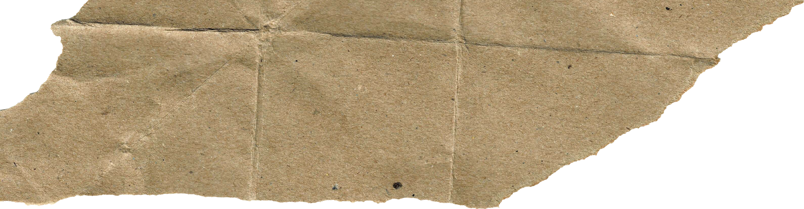
PROJECT TITLE
Interactive digital portfolio using front end development

Slide 4
AGENDA
1.Problem Statement
2.Project Overview
3.End Users
4.Tools and Technologies
5.Portfolio design and Layout
6.Features and Functionality
7.Results and Screenshots
8.Conclusion
9.Github Link

Slide 5
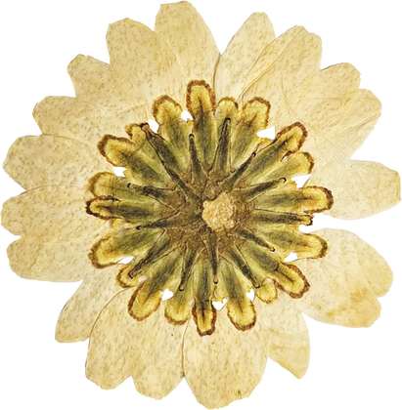


PROBLEM STATEMENT
In the present digital age, students, job seekers, and professionals require a proper platform to highlight their achievements, projects, and skills. Traditional resumes or CVs are limited to text and fail to create a strong impression. Therefore, a personal portfolio website becomes essential, as it provides a digital presence where all important details can be displayed in an attractive and interactive format.

Slide 6


PROJECT OVERVIEW
This project is a personal portfolio website built using only HTML and CSS. The website allows the user to present their profile, skills, certificates, projects, and contact details in one place. The design is simple yet professional, ensuring that visitors can easily navigate through the sections. It also demonstrates the effective use of HTML for structure and CSS for styling, animations, and responsive design.

Slide 7

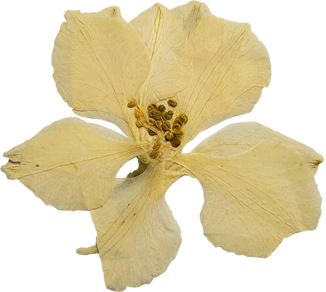

WHO ARE THE END USERS?
Freelancers and Professionals
Students
Job Seekers
Students can use the portfolio to showcase their academic achievements, projects, and extracurricular activities, helping them stand out in higher studies or internship applications.
Job seekers can present their skills, certifications, and experience in a professional way, making it easier for recruiters to evaluate their profiles.
Freelancers and professionals can highlight their past work, client projects, and career milestones to attract new opportunities and build a strong online presence

Slide 8

Tools and Techniques
Tools Used:
HTML
CSS
Text Editor (VS Code, Sublime Text, Notepad++) – for writing and editing code efficiently.
Browser (Google Chrome, Edge, Firefox) – for testing and previewing the website.
used to build the basic structure of the website. It defines sections, forms, headings, and lists. Acts as the foundation for organizing all content on the site.
used for styling and layout of the website. It controls colors, fonts, and spacing. Responsive design, hover effects, shadows, and gradients were applied to enhance visual appeal.

Slide 9


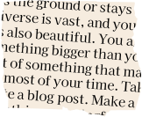
PORTFOLIO DESIGN AND LAYOUT
The design follows a clean and organized layout:
Header: A sticky navigation bar with links to all sections.
Profile Section: Displays a circular profile picture, name, and tagline.
About Section: A short introduction about the person.
Skills Section: Progress bars showing knowledge levels in HTML, CSS, JavaScript, and Python.
Certificates Section: A list of certifications with icons.
Projects Section: Showcases important projects with short descriptions.
Contact Section: A simple form to collect name, email, and message.
Footer: Contains copyright information.

Slide 10
FEATURES AND FUNCTIONALITY
Modern UI with gradients, shadows, and hover animations.
Sticky Navbar for easy navigation between sections.
Interactive Profile Image with hover zoom effect.
Skill Progress Bars to visually represent knowledge levels.
Certificates and Projects displayed in a card-like style.
Contact Form to allow visitors to send messages.
Responsive Design that works on both computers and mobile devices.

Slide 11
Results and Screenshot
The output is a functional personal portfolio website that gives the user a professional online presence. It clearly highlights skills, certificates, and projects in an attractive manner.
Expected Screenshot View:
Top section with a header and navigation bar.
Center profile photo with user’s name and role.
White background cards for “About Me,” “Skills,” “Certificates,” “Projects,” and “Contact.”
Footer at the bottom with copyright text.

Slide 12
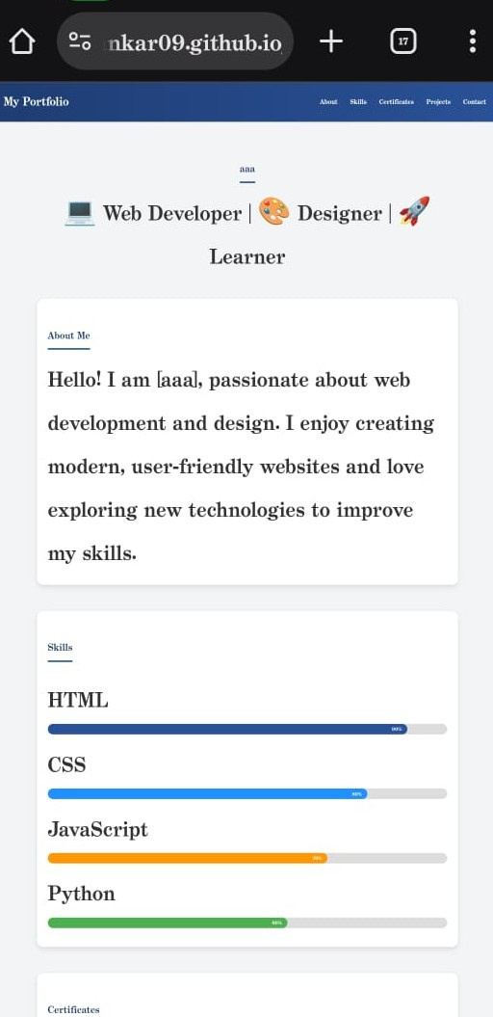
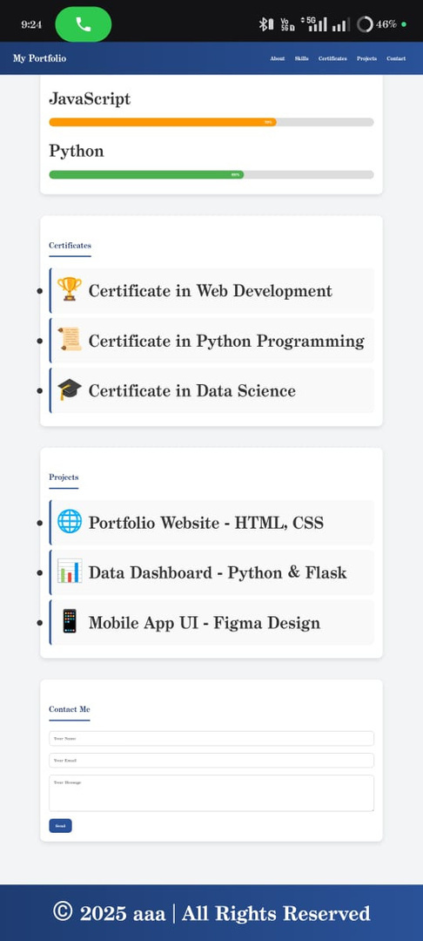

Slide 13
https://pavisankar09.github.io/Pavithra-/
CONCLUSION
This project successfully demonstrates the use of HTML and CSS to build a personal portfolio website. The design is simple, user-friendly, and professional. It helps students, freelancers, and job seekers present their skills and achievements online. The project is also a strong practice for beginners to understand web design principles, and it can be extended further by adding JavaScript or backend features in the future.
GITHUB LINK:
https://pavisankar09.github.io/Pavithra-/
Notes:
13

Slide 14
Thank you!

